Slide 1
INT396 · UNSUPERVISED LEARNING
UNIT 1
Foundations of Unsupervised Learning
What you can learn from data when nobody has told you the answer - and why the whole thing rests on how you choose to measure 'similar'.
Supervised vs Unsupervised vs Semi-Supervised • Problem Formulation • Market Segmentation • Anomaly & Fraud Detection • Euclidean • Manhattan • Cosine • Why Metric Choice Matters
School of Computer Science & Engineering
Session 2026-27 · L:2 T:0 P:2 · Credits: 3

Slide 2
UNIT I ROADMAP
UNIT 1
What This Unit Covers
Four topics. The last one is the foundation the rest of the course stands on.
Learning paradigms
Supervised vs. Unsupervised vs. Semi-Supervised learning
What each needs, what each produces, and when each applies
Problem formulation
How to state an unsupervised problem precisely
Why there is no ground truth - and what you do about it
Real-life use cases
Market segmentation and customer behaviour analysis
Anomaly and fraud detection
Pattern discovery in biological and social data
Distance and similarity metrics
Euclidean, Manhattan and Cosine similarity
When and WHY the choice of distance changes your answer
1 · Three paradigms
what labels do you have?
2 · Problem formulation
five things you must state
3 · Real use cases
segmentation, fraud, biology
4 · Distance metrics
the foundation under all of it
each one depends on the one below it
SHOW OF HANDS Which of these four have you met before today?
INT396 · Unit 1: Foundations of Unsupervised Learning
2

Slide 3
LEARNING OUTCOMES
UNIT 1
Learning Outcomes
By the end of this unit you should be able to:
Distinguish supervised, unsupervised and semi-supervised learning, with an example of each.
Remember
recall the terms
1
Formulate an unsupervised problem using all five specifications.
2
Understand
explain them in your own words
Justify an evaluation strategy given that no ground truth exists.
3
Apply
use them on a problem you have not seen
Compute Euclidean, Manhattan and cosine distance by hand for a given pair.
4
Analyse
choose between them and justify it
Select and defend a distance metric and a scaling decision for a new dataset.
5
the levels this unit is assessed at
INT396 · Unit 1: Foundations of Unsupervised Learning
3

Slide 4
01
IN THIS SECTION
Learning with a teacher, and learning by self-exploration
What a 'label' actually is, and why labels are expensive
The three paradigms side by side
Where reinforcement learning fits
Classifying unfamiliar problems
SECTION
Supervised vs Unsupervised vs Semi-Supervised
1 · Paradigms
2 · Formulation
3 · Use cases
4 · Metrics
5 · Why it matters
you are here

Slide 5
1.1 LEARNING PARADIGMS
UNIT 1
Supervised Learning - Learning With a Teacher
You already know the answer for the training data. The job is to generalise it.
Input features X together with a LABEL y for every single example.
The task learn a mapping f such that f(X) ≈ y, then apply it to data you have never seen.
Two families CLASSIFICATION predicts a category; REGRESSION predicts a number.
Success is measurable hold back some labelled data, predict it, compare with the truth. Accuracy, precision, recall.
The catch somebody had to produce every one of those labels, by hand.
The data 10,000 emails. Each one already stamped SPAM or NOT SPAM by a human being.
The features X words present, number of links, sender reputation, time sent.
The label y SPAM / NOT SPAM. Binary. Unambiguous. Given.
What is learned a decision rule that maps a new, unseen email to one of the two classes.
Why it works the categories were decided BEFORE learning started. The algorithm only had to find the boundary.
What it needs and does
The spam filter, concretely
Features X
what you measure
+ Label y
supplied by a human
Learn f
so that f(X) ≈ y
Predict
on unseen data
NAME ONE a supervised task you personally used today - and say who produced its labels.
INT396 · Unit 1: Foundations of Unsupervised Learning
5

Slide 6
1.1 LEARNING PARADIGMS
UNIT 1
Unsupervised Learning - Learning by Self-Exploration
No labels. No teacher. No answer key - and therefore no single correct answer.
Input features X only. There is NO y. Nothing is labelled.
The task discover structure that is already present in the data - groups, patterns, outliers, or a lower-dimensional shape.
Main families CLUSTERING (group similar items), DIMENSIONALITY REDUCTION (compress features), ASSOCIATION (find co-occurrence), ANOMALY DETECTION (find the odd ones).
Success is hard to measure there is no truth to compare against. You need internal measures, or a human, or a downstream business result.
The pay-off it works on data nobody has labelled - which is almost all data that exists.
The situation a room with 5,000 books dumped on the floor. No Dewey system. No genre stickers. No catalogue.
The task organise them so the room is usable.
What you would do flick through, notice some are about cooking, some about history, some are children's picture books - and start piles.
The key point nobody told you 'cooking' was a category. You INFERRED the categories from the books themselves.
The uncomfortable part your colleague sorts them by size and colour instead - and produces a beautiful, usable room. Who is wrong?
What it needs and does
The library, concretely
Features X only
no label column
Find structure
groups, shapes, outliers
You name them
meaning is YOUR job
No accuracy score
nothing to compare against
THINK-PAIR-SHARE 60 seconds: name a dataset you personally generate every day that has NO labels attached to it.
INT396 · Unit 1: Foundations of Unsupervised Learning
6

Slide 7
1.1 LEARNING PARADIGMS
UNIT 1
Semi-Supervised Learning - A Few Labels, and a Lot of Data
The realistic middle ground - and in industry, the most common situation of the three.
Input a SMALL amount of labelled data plus a LARGE amount of unlabelled data.
Why it exists labels are expensive and slow; raw data is cheap and abundant. This is the normal situation, not the exception.
Core assumption points close together in feature space probably share a label. The unlabelled data reveals the SHAPE; the few labels tell you what to call each region.
Typical methods self-training (label confidently, retrain), and label propagation across a graph of similar points.
The risk one wrong confident label can propagate through the whole dataset and poison it.
The data 50,000 chest scans in a hospital archive. All unlabelled.
The labels available 300 of them have been read and annotated by a consultant radiologist.
Why not just label them all at ~10 minutes per scan, 50,000 scans is over 8,000 consultant-hours. Nobody is paying for that.
What semi-supervised does uses all 50,000 to learn what scans generally LOOK like, and the 300 to attach clinical meaning to the structure it found.
The result far better than 300 labelled scans alone, at a tiny fraction of the labelling cost.
What it is and why it exists
Medical imaging, concretely
UNLABELLED
93%
50,000 scans - gives the SHAPE
LABELLED
7%
300 - gives the MEANING
structure from the many, meaning from the few
DO THE SUM At ~10 minutes a scan, how long would labelling all 50,000 take one radiologist?
INT396 · Unit 1: Foundations of Unsupervised Learning
7

Slide 8
1.1 LEARNING PARADIGMS
UNIT 1
The Three Paradigms Side by Side
Same data, three different situations - decided entirely by which labels you happen to have.
 | Supervised | Unsupervised | Semi-Supervised
Labels needed | Every example | None at all | A small fraction
The goal | Predict a known target | Discover unknown structure | Predict, using structure to stretch few labels
Typical output | A class or a number | Groups, components, outliers | A class or a number
Evaluation | Direct: accuracy vs. truth | Indirect: internal measures or human judgement | Direct, on the labelled held-out part
Cost driver | Human labelling effort | Compute and interpretation | A little labelling, a lot of data
Example | Spam filter from labelled emails | Grouping customers with no predefined segments | Diagnosing scans from 300 annotated out of 50,000
ONE QUESTION Look at your own project data. Which row are you in - and how do you know?
INT396 · Unit 1: Foundations of Unsupervised Learning
8

Slide 9
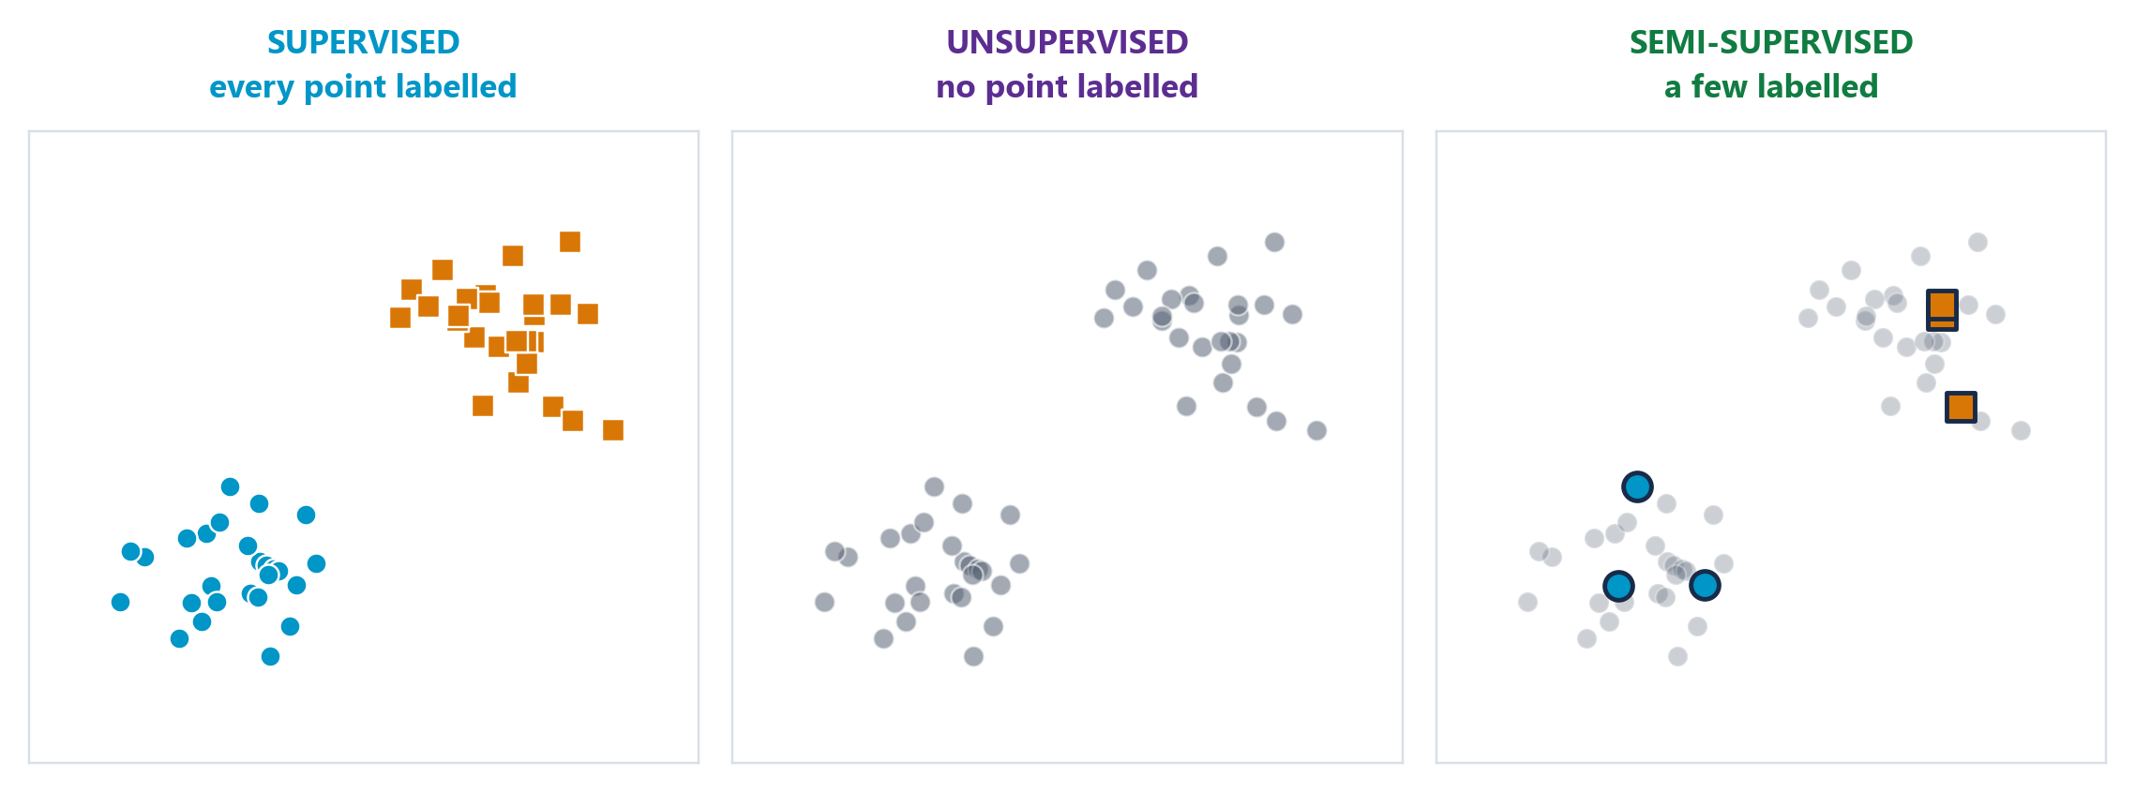
1.1 LEARNING PARADIGMS
UNIT 1
The Three Paradigms, Side by Side
HOW TO READ THIS FIGURE
Left - supervised every point carries its label. Shape and colour = the class you were told.
Middle - unsupervised identical points, all grey. Nobody told you anything.
Right - semi-supervised a handful of labelled points against a crowd of unlabelled ones.
The data is the same in all three panels. Only the LABELS differ.
Which is why the paradigm is decided by what labels you happen to have - not by the algorithm you prefer.
TAKEAWAY Same points, three panels. The paradigm is a property of your labels, not of your data.
INT396 · Unit 1: Foundations of Unsupervised Learning
9

Slide 10
1.1 LEARNING PARADIGMS
UNIT 1
A Note on the Fourth Paradigm: Reinforcement Learning
What it is an agent takes actions in an environment and receives REWARDS or penalties. It learns a policy that maximises reward over time.
Why it is not unsupervised there IS a signal - the reward. It is just delayed, sparse and evaluative rather than a per-example label.
Why it is not supervised nobody tells you the correct action. You are told how good the outcome was, AFTER the fact, sometimes much later.
The one-line distinction supervised = 'the answer was cat'. reinforcement = 'that went badly'. unsupervised = silence.
Where you will meet it game playing, robotics, recommendation, resource scheduling. Not in this course - but do not confuse it with unsupervised learning in an exam.
AGENT
chooses an action
EXAM TIP · Not on this syllabus - but you should know why it is different
action aₜ
state sₜ₊₁ + reward rₜ
both on the same arrow
ENVIRONMENT
everything outside the agent
the reward comes FROM the environment
SORT THEM 'the answer was cat' / 'that went badly' / silence - which is which?
INT396 · Unit 1: Foundations of Unsupervised Learning
10

Slide 11
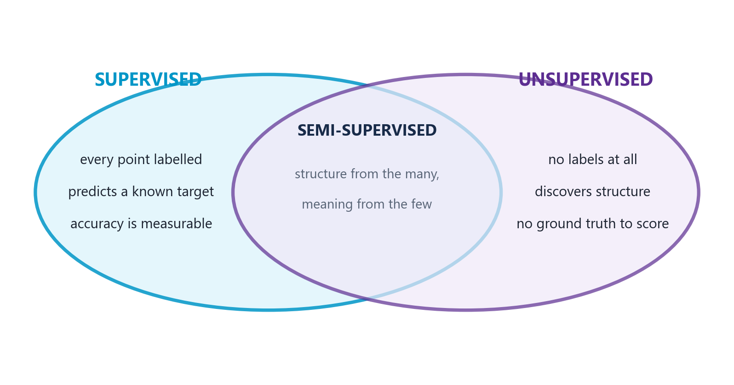
1.1 LEARNING PARADIGMS
UNIT 1
What Each Paradigm Needs, as a Venn Diagram
HOW TO READ THIS FIGURE
The overlap is the point semi-supervised is not a third thing - it is genuinely both at once.
From the unsupervised side it uses all the unlabelled data to learn the SHAPE.
From the supervised side it uses the few labels to attach MEANING to that shape.
Core assumption points close together in feature space probably share a label.
Why it matters in industry this overlap is the normal situation, not the exception.
TAKEAWAY Structure from the many, meaning from the few. That division of labour is what semi-supervised buys you.
INT396 · Unit 1: Foundations of Unsupervised Learning
11

Slide 12
CLASSIFICATION DRILL
UNIT 1
Which Paradigm? Four Real Problems
THE PROBLEM
A bank wants to know which loan applicants will default, from 40,000 past applications with known outcomes
An e-commerce site wants to find natural customer groups - it has no idea how many groups exist
A hospital has 50,000 scans, of which 300 are annotated
A telecom company wants to find SIM cards behaving unlike any other SIM card on the network
STEP-BY-STEP SOLUTION
Loan default SUPERVISED - classification. Every past application has a known outcome, which is the label y. Target is defined and filled in.
Customer groups UNSUPERVISED - clustering. There is no 'correct' segment column anywhere. Note the giveaway phrase: 'no idea how many groups exist'.
Hospital scans SEMI-SUPERVISED. A few hundred labels against fifty thousand unlabelled examples - the classic ratio.
Odd SIM cards UNSUPERVISED - anomaly detection. Nobody has a list of which SIMs are fraudulent; if they did, it would be supervised.
The tell in every case look for the target column. Present and complete → supervised. Absent → unsupervised. Sparse → semi-supervised.
WHY IT MATTERS
'We don't know how many groups' is always an unsupervised signal
'Find the unusual ones' with no list of known-bad = anomaly detection
A few labels against a lot of data = semi-supervised, every time
THE TELL
S
labels present and complete
U
no target column at all
SS
a few labels, lots of raw data
?
always look at the spreadsheet first
ANSWER The paradigm is decided by the labels you have, not by the algorithm you prefer.
INT396 · Unit 1: Foundations of Unsupervised Learning
12

Slide 13
CHECK YOUR UNDERSTANDING
UNIT 1
Quick Check - Section 1
QUICK CHECK
A streaming service groups its users into 'listening tribes'. Nobody defined the tribes in advance, and nobody knows how many there should be. Which paradigm is this?
FEATURE (X)
listening history
what you MEASURE
LABEL (y)
does not exist
what you PREDICT
A
Supervised learning - the listening history is the label
B
Unsupervised learning - clustering
C
Semi-supervised learning - some users have stated preferences
D
Reinforcement learning - the service is rewarded by watch time
ANSWER: B There is no target column. The tribes do not exist until the algorithm creates them, and even the NUMBER of tribes is unknown. That is clustering, which is unsupervised. Listening history is a FEATURE (X), not a label (y) - confusing the two is the most common error in this topic.
◆ click to reveal the answer
confusing these two is the classic error
INT396 · Unit 1: Foundations of Unsupervised Learning
13

Slide 14
02
IN THIS SECTION
Why formulation is HARDER without labels
The five things you must specify before you cluster
A worked formulation: e-commerce segmentation
The evaluation problem, and three honest answers to it
SECTION
Problem Formulation for Unsupervised Learning
1 · Paradigms
2 · Formulation
3 · Use cases
4 · Metrics
5 · Why it matters
you are here

Slide 15
1.2 PROBLEM FORMULATION
UNIT 1
Why Formulation Is Harder Without Labels
In supervised learning, the label pins everything down it defines what the task is, what counts as success, which features matter, and when you are finished.
Remove the label and all four of those become YOUR decisions and every one of them is a judgement call you must be able to defend.
Decision 1 - What does 'similar' mean? the algorithm has no opinion. You supply it by choosing features and a distance metric. This is section four.
Decision 2 - How many groups? there is rarely a correct answer. 3 segments and 30 segments can both be defensible for the same customers.
Decision 3 - What counts as a good result? no accuracy score exists. You need internal measures, human judgement, or a downstream outcome.
Decision 4 - When do you stop? without a target metric, 'good enough' has to be defined by the business question, not by the data.
THE LABEL USED TO ANSWER ALL FOUR
COMMON PITFALL · The label was doing more work than you realised
What does 'similar' mean?
1
How many groups?
2
What counts as a good result?
3
When do you stop?
4
THINK ABOUT IT If two teams cluster the same customers and get completely different groups - is one of them wrong?
INT396 · Unit 1: Foundations of Unsupervised Learning
15

Slide 16
1.2 PROBLEM FORMULATION
UNIT 1
Formulating an Unsupervised Problem: Five Specifications
Five things you must state explicitly, because nothing in the data will state them for you.
SPECIFICATION 1
The objects
WHAT are you grouping or analysing?
Customers? Transactions? Documents? Genes?
One row of your data = one object
Getting this wrong invalidates everything after it
SPECIFICATION 2
The features
WHICH measurable properties describe each object?
Age, income, visits/month, average basket value
Every feature you include shapes what 'similar' means
Irrelevant features actively add noise
SPECIFICATION 3
The similarity measure
HOW do you decide two objects are alike?
Euclidean, Manhattan, Cosine - section four
Includes the scaling decision, which is not optional
The single most consequential choice you make
SPECIFICATION 4
The structure sought
WHAT KIND of pattern are you looking for?
Groups? A lower-dimensional shape? Outliers? Rules?
This chooses the family of algorithm
Clustering vs. dimensionality reduction vs. anomaly detection
SPECIFICATION 5
The success criterion
HOW will you judge the result - before you run it?
Internal measure, human review, or business outcome
Decide this FIRST, or you will rationalise whatever you get
The hardest specification, and the most skipped
TOGETHER
= A well-posed problem
Objects · Features · Similarity · Structure · Success
Write all five down BEFORE opening your editor
Any one left implicit will be decided by accident
This is your checklist for every practical this semester
APPLY IT Pick any dataset you know. Say its OBJECT out loud in three words.
INT396 · Unit 1: Foundations of Unsupervised Learning
16

Slide 17
1.2 PROBLEM FORMULATION
UNIT 1
Worked Formulation: E-Commerce Customer Segmentation
THE PROBLEM
An online retailer has 2 years of order history
Marketing wants to 'understand our customers better'
There are no existing segments and no target column
Task: turn that vague request into a well-posed problem
STEP-BY-STEP SOLUTION
1. Objects the CUSTOMER, not the order. Aggregate the order table to one row per customer first - this step is easy to skip and fatal.
2. Features recency (days since last order), frequency (orders per year), monetary (average basket value), category spread, discount sensitivity. The classic RFM starting point.
3. Similarity Euclidean distance ON STANDARDISED features - because monetary value is in thousands of rupees and frequency is in single digits.
4. Structure sought clusters. Try k from 2 to 8 and inspect - the business can realistically act on 3 to 6 segments.
5. Success criterion agreed in advance: each segment must be describable in one sentence a marketer understands, and must differ measurably in at least two features.
Why criterion 5 is the good one it is a BUSINESS test, not a mathematical one. A statistically excellent clustering nobody can act on has failed.
WHY IT MATTERS
'Understand our customers better' is not a problem statement
Aggregate to the right OBJECT before anything else
A success criterion agreed in advance stops you rationalising the output
THE CLASSIC STARTING POINT
R
Recency - days since last order
F
Frequency - orders per year
M
Monetary - average basket
ANSWER Vague request → five explicit specifications → a problem you can actually solve.
INT396 · Unit 1: Foundations of Unsupervised Learning
17

Slide 18
1.2 PROBLEM FORMULATION
UNIT 1
The Evaluation Problem - How Do You Know It Worked?
No ground truth does not mean no evaluation - it means you must choose your evidence deliberately.
The core difficulty there is no ground truth. Nobody wrote down the correct answer, so there is nothing to compare against.
You cannot report accuracy '94% accurate' is meaningless when no correct grouping exists.
Different valid answers changing the metric, the features or k gives a different clustering - and several may be defensible.
The temptation run it, look at the output, then invent a story about why it is good. This is extremely easy to do accidentally.
1. Internal measures score the geometry itself - are clusters tight inside and far apart outside? Silhouette score, within-cluster sum of squares. No labels required.
2. External / human judgement show the segments to a domain expert. Can they name each one? Do they recognise them? Unglamorous and very effective.
3. Downstream outcome the strongest test. Run a campaign targeted by segment and measure whether response improved. The clustering is good if the DECISION it enabled was good.
Why this is genuinely hard
Three honest ways to evaluate
Internal
is the geometry tight? silhouette
Human
can an expert name the groups?
Downstream
did the DECISION improve?
RANK THEM Which of the three would convince YOU? Which would convince a manager who does not know what a silhouette score is?
INT396 · Unit 1: Foundations of Unsupervised Learning
18

Slide 19
CHECK YOUR UNDERSTANDING
UNIT 1
Quick Check - Section 2
QUICK CHECK
You cluster customers and get a silhouette score of 0.71 - geometrically excellent. Marketing looks at the segments and cannot describe a single one of them. What is the correct conclusion?
GEOMETRY
0.71
silhouette says: excellent
MEANING
none
marketing can name nothing
A
The clustering is good; marketing needs training
B
The clustering is bad; the silhouette score must be wrong
C
The clustering is geometrically sound but has failed its success criterion
D
You should increase k until the segments become describable
ANSWER: C A high silhouette score says the clusters are tight and well separated - a statement about GEOMETRY only. It says nothing about meaning. If the agreed success criterion was 'describable and actionable', the result has failed that criterion, and the honest next step is to revisit the FEATURES, not to blame the audience.
◆ click to reveal the answer
both statements are true at the same time
INT396 · Unit 1: Foundations of Unsupervised Learning
19

Slide 20
03
IN THIS SECTION
Market segmentation
Customer behaviour analysis
Anomaly and fraud detection
Pattern discovery in biological and social data
What all four have in common
SECTION
Real-Life Use Cases
1 · Paradigms
2 · Formulation
3 · Use cases
4 · Metrics
5 · Why it matters
you are here

Slide 21
1.3 REAL-LIFE USE CASES
UNIT 1
Market Segmentation and Customer Behaviour Analysis
USE CASE 1
Market segmentation
Divide a customer base into groups with similar behaviour
Input: RFM, demographics, category mix, channel
Output: 3-6 named, actionable segments
Value: one message per segment beats one message for everyone
USE CASE 1
What it looks like in practice
'Bargain hunters' - only ever buy during sales
'Loyal regulars' - small, frequent, full-price purchases
'Big occasional' - twice a year, very large baskets
'Lapsed' - were frequent, nothing for 6 months
USE CASE 2
Customer behaviour analysis
Discover PATTERNS in what people do, not who they are
Sequence of pages before a purchase; time-of-day patterns
Association rules: what gets bought together
Basket analysis is the classic example
USE CASE 2
Why it is unsupervised
Nobody wrote down the list of behaviours to look for
The patterns are discovered, not verified
Often surprising - which is the whole point
A supervised model can only confirm what you suspected
WHAT GOOD SEGMENTS LOOK LIKE
bargain hunters - only buy in a sale
B
loyal regulars - small, frequent, full price
L
big occasional - twice a year, huge basket
O
lapsed - were frequent, now nothing
X
BRAINSTORM Name a segment YOU belong to as a customer of some app. What behaviour defines it?
INT396 · Unit 1: Foundations of Unsupervised Learning
21

Slide 22
1.3 REAL-LIFE USE CASES
UNIT 1
Anomaly Detection, Fraud, and Pattern Discovery
Two use cases where unsupervised learning is not just convenient - it is the only option.
USE CASE 3
Anomaly and fraud detection
Find the points that do not resemble anything else
Card fraud, network intrusion, machine failure, insurance abuse
Anomalies are RARE - often well under 1% of records
Which is exactly why labels are scarce
USE CASE 3
Why unsupervised beats supervised here
A supervised model learns PAST fraud patterns
So it catches fraud that resembles fraud you already know
New schemes look like nothing in the training set
Unsupervised catches 'unlike anything' - including the new
USE CASE 4
Biological data
Cluster gene expression profiles across patients
Groups emerge that correspond to DISEASE SUBTYPES
Nobody knew the subtypes existed beforehand
Different subtypes respond to different treatments
USE CASE 4
Social data
Community detection in social networks
Topic discovery across millions of documents
Detecting coordinated inauthentic behaviour
Structure in who-connects-to-whom, not in what they say
FOUR PLACES LABELS DO NOT EXIST
fraud - unlike anything seen before
!
faults - nobody labels 'about to fail'
~
disease subtypes nobody knew existed
DNA
communities in a social graph
@
INT396 · Unit 1: Foundations of Unsupervised Learning
22

Slide 23
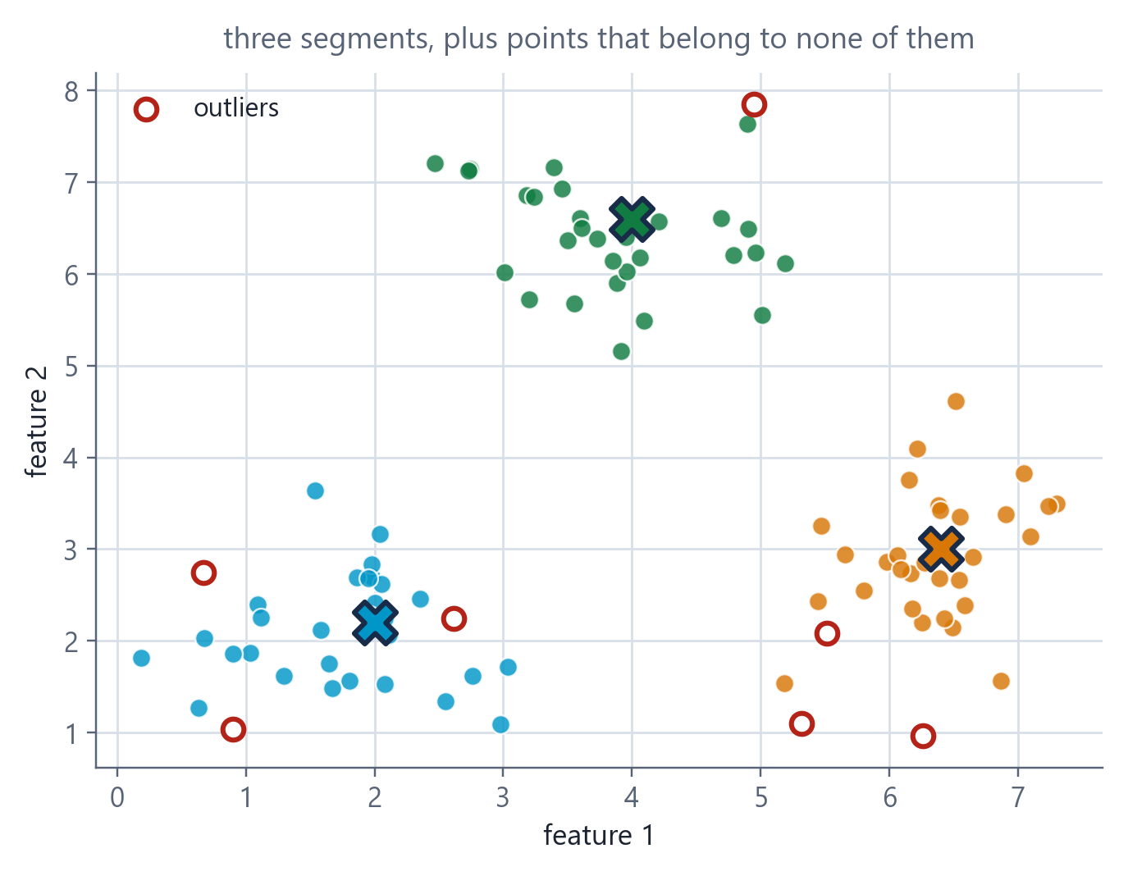
1.3 REAL-LIFE USE CASES
UNIT 1
What Clustering Actually Produces
HOW TO READ THIS FIGURE
The coloured groups the segments. Nobody defined them - the algorithm found them.
The X marks each cluster's centre. In K-Means this is literally the mean of its members.
The hollow red circles points far from every group - candidate anomalies.
Two use cases, one picture segmentation reads the clusters; anomaly detection reads the leftovers.
The catch the axes are unlabelled here. On real data YOU chose those features - and that choice made these groups.
TAKEAWAY Segmentation and anomaly detection are the same computation read two different ways.
INT396 · Unit 1: Foundations of Unsupervised Learning
23

Slide 24
1.3 REAL-LIFE USE CASES
UNIT 1
Case Study: Detecting Fraudulent Card Transactions
THE PROBLEM
A bank processes millions of card transactions per day
Confirmed fraud is roughly 0.1% of transactions
Confirmed labels arrive weeks late, via customer complaints
Task: design an unsupervised approach
STEP-BY-STEP SOLUTION
1. Objects the TRANSACTION - but described relative to that cardholder's own history, not against the population.
2. Features amount vs. that customer's usual amount; distance from their usual locations; time of day vs. their pattern; merchant category novelty; time since previous transaction.
3. Similarity distance in a standardised feature space - amounts and distances live on wildly different scales.
4. Structure sought ANOMALIES, not clusters. Points far from every dense region of that customer's normal behaviour.
5. Success criterion agreed in advance: catch a useful share of confirmed fraud while keeping false alarms low enough that genuine customers are not blocked.
The key design insight 'normal' is defined PER CUSTOMER. Rs. 40,000 is unremarkable for one cardholder and a screaming alarm for another. A global threshold fails both.
WHY IT MATTERS
Rare-event problems make labels scarce AND late - a double bind
Defining 'normal' per-entity is usually stronger than a global rule
The false-alarm cost is a business decision, not a technical one
EVERY FEATURE IS RELATIVE
1
amount vs THIS customer's normal
2
distance from THEIR usual places
3
hour vs THEIR pattern
4
merchant category novelty
ANSWER Anomaly detection with no labels — because the labels arrive weeks too late to be useful.
INT396 · Unit 1: Foundations of Unsupervised Learning
24

Slide 25
1.3 REAL-LIFE USE CASES
UNIT 1
What All Four Use Cases Have in Common
1. The categories do not exist yet segments, behaviour patterns, anomaly types and disease subtypes are all OUTPUTS, not inputs. Nobody could have supplied them.
2. Labelling is impossible, impractical or too slow you cannot label 'which segment' because segments do not exist; fraud labels arrive weeks late; nobody knew the disease subtypes.
3. There is a lot of unlabelled data and it is cheap. This is the resource unsupervised learning is designed to exploit.
4. Discovery has real value finding something you did not think to ask about is the point. A supervised model can only confirm what you already suspected.
5. Success is judged downstream by the campaign response, the fraud prevented, the treatment chosen - not by an accuracy score.
Categories do not exist yet
they are the OUTPUT
KEY CONCEPT · The shape of a genuine unsupervised problem
Labelling is impractical
or arrives far too late
Unlabelled data is abundant
and cheap
Discovery has value
you learn what you did not ask
Judged downstream
by the decision it enabled
APPLY IT Think of a problem from your own life or work. Does it have all five? If not, which one is missing - and is unsupervised learning really the right tool?
INT396 · Unit 1: Foundations of Unsupervised Learning
25

Slide 26
04
IN THIS SECTION
Why the metric IS the algorithm's definition of 'similar'
Euclidean distance - the crow flies
Manhattan distance - the city blocks
Cosine similarity - direction, not magnitude
Hands-on calculation on all three
SECTION
Distance and Similarity Metrics
1 · Paradigms
2 · Formulation
3 · Use cases
4 · Metrics
5 · Why it matters
you are here

Slide 27
1.4 DISTANCE AND SIMILARITY
UNIT 1
The Distance Metric IS the Definition of 'Similar'
What a distance metric does takes two objects, each described by a list of numbers, and returns a single number: how far apart they are.
Why it is not a detail clustering means grouping things that are close. Change what 'close' means and the groups change - same data, same algorithm, different answer.
The four properties of a true metric non-negativity d(a,b) ≥ 0; identity d(a,a) = 0; symmetry d(a,b) = d(b,a); and the triangle inequality d(a,c) ≤ d(a,b) + d(b,c).
Similarity vs. distance they are inverses. High similarity = small distance. Cosine gives SIMILARITY (higher is more alike); Euclidean and Manhattan give DISTANCE (lower is more alike). Do not mix them up.
The practical consequence before you cluster anything, you must be able to finish this sentence: 'two of my objects are similar when ___'.
A TRUE METRIC OBEYS FOUR RULES
KEY CONCEPT · The algorithm has no opinion. You supply one.
non-negativity d(a,b) ≥ 0
1
identity d(a,a) = 0
2
symmetry d(a,b) = d(b,a)
3
triangle d(a,c) ≤ d(a,b) + d(b,c)
4
FINISH THE SENTENCE 'Two of my objects are similar when ___.' Say yours out loud.
INT396 · Unit 1: Foundations of Unsupervised Learning
27

Slide 28
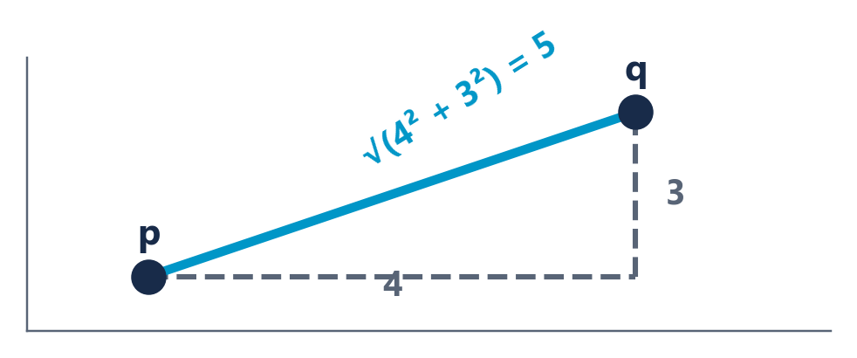
1.4 DISTANCE AND SIMILARITY
UNIT 1
Euclidean Distance - How the Crow Flies
The default metric - and the right one when your features are continuous and comparably scaled.
EUCLIDEAN DISTANCE IN 2 DIMENSIONS
d(p, q) = √[ (p₁ − q₁)² + (p₂ − q₂)² ]
Pythagoras. The straight-line distance between two points.
WHERE, AND WHEN TO USE IT
p, q two objects, each a list of n feature values
n the number of features (dimensions)
Σ sum over all n features
Squaring makes every difference positive AND penalises large gaps disproportionately - one big difference outweighs several small ones
Also called the L2 norm, or the 2-norm
Use it when features are continuous, on comparable scales, and straight-line closeness is meaningful
EUCLIDEAN DISTANCE IN N DIMENSIONS
d(p, q) = √[ Σᵢ₌₁ⁿ (pᵢ − qᵢ)² ]
Same idea, more features. Also written as the L2 norm ‖p − q‖₂.
WORKED: P = (2, 3), Q = (6, 6)
d = √[ (2−6)² + (3−6)² ] = √[16 + 9] = √25 = 5
The classic 3-4-5 triangle. Do this one by hand now.
ON PAPER p = (2,3), q = (6,6). Compute it before I do.
INT396 · Unit 1: Foundations of Unsupervised Learning
28

Slide 29
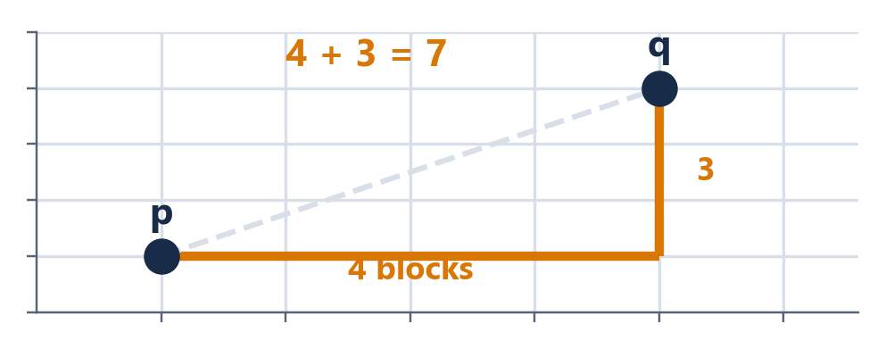
1.4 DISTANCE AND SIMILARITY
UNIT 1
Manhattan Distance - City Blocks
You cannot walk through buildings - so sometimes the straight line is the wrong measure.
MANHATTAN DISTANCE IN 2 DIMENSIONS
d(p, q) = |p₁ − q₁| + |p₂ − q₂|
Sum of absolute differences. No squaring, no square root.
WHERE, AND WHEN TO USE IT
| · | absolute value - drop the minus sign
No squaring so every feature contributes in proportion to its difference - one big gap does NOT dominate
Also called L1 norm, taxicab distance, city-block distance
More robust to outliers than Euclidean, precisely because it does not square
Better in high dimensions where Euclidean distances tend to concentrate and lose contrast
Use it when movement is constrained to axes, or features are independent counts, or outliers are a concern
MANHATTAN DISTANCE IN N DIMENSIONS
d(p, q) = Σᵢ₌₁ⁿ |pᵢ − qᵢ|
Also called the L1 norm, taxicab distance, or city-block distance.
WORKED: THE SAME P = (2, 3), Q = (6, 6)
d = |2−6| + |3−6| = 4 + 3 = 7 (Euclidean was 5)
Same two points. Different metric. Different answer. 7 vs 5.
SAME TWO POINTS Why is the answer 7 and not 5?
INT396 · Unit 1: Foundations of Unsupervised Learning
29

Slide 30
1.4 DISTANCE AND SIMILARITY
UNIT 1
Euclidean vs Manhattan - Same Points, Different Worlds
Neither is correct in general. Each is correct for a different question.
Euclidean (L2)
Manhattan (L1)
Physical picture
As the crow flies - straight line
As the taxi drives - along the grid
Formula
√Σ(pᵢ − qᵢ)²
Σ|pᵢ − qᵢ|
p=(2,3), q=(6,6)
5
7
Effect of one big gap
Dominates - squaring amplifies it
Contributes in proportion - no amplification
Outlier sensitivity
High
Lower - more robust
Shape of 'distance 1'
A circle
A diamond
Choose it when
Continuous, comparable features; straight-line closeness is meaningful
Axis-constrained movement; count features; outliers present; high dimensions
DECIDE A delivery robot moving along warehouse aisles. Which metric describes its real travel distance - and why?
INT396 · Unit 1: Foundations of Unsupervised Learning
30

Slide 31
HANDS-ON CALCULATION
UNIT 1
Hands-On: Both Metrics on Three Customers
THE PROBLEM
Customer A = (visits: 2, spend: 5)
Customer B = (visits: 5, spend: 9)
Customer C = (visits: 8, spend: 5)
Question: which customer is A more similar to - B or C?
STEP-BY-STEP SOLUTION
Euclidean A→B √[(2−5)² + (5−9)²] = √[9 + 16] = √25 = 5.00
Euclidean A→C √[(2−8)² + (5−5)²] = √[36 + 0] = √36 = 6.00
Euclidean verdict A is closer to B (5.00 < 6.00). So B is more similar.
Manhattan A→B |2−5| + |5−9| = 3 + 4 = 7
Manhattan A→C |2−8| + |5−5| = 6 + 0 = 6
Manhattan verdict A is closer to C (6 < 7). So C is more similar.
The point The two metrics DISAGREE about who A's nearest neighbour is. Same three customers, same numbers, opposite conclusions.
WHY IT MATTERS
Euclidean punishes the single large gap (6 in visits) more heavily
Manhattan treats a gap of 6 in one feature the same as 3+3 across two
If a nearest-neighbour answer flips, so will your clusters
EUCLIDEAN
B
5.00 beats 6.00
MANHATTAN
C
6 beats 7
ANSWER Euclidean says B. Manhattan says C. The metric changed the answer.
same three customers, opposite answers
INT396 · Unit 1: Foundations of Unsupervised Learning
31

Slide 32
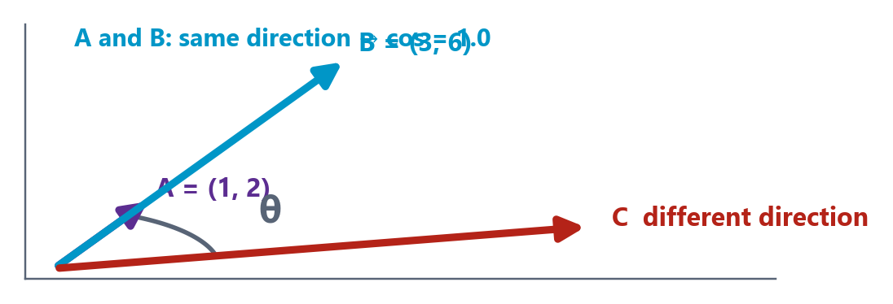
1.4 DISTANCE AND SIMILARITY
UNIT 1
Cosine Similarity - Direction, Not Magnitude
Ignores how BIG the vectors are and asks only whether they point the same way.
COSINE SIMILARITY
cos(θ) = (A · B) / (‖A‖ ‖B‖) = Σ AᵢBᵢ / (√Σ Aᵢ² · √Σ Bᵢ²)
The cosine of the angle between two vectors. Range −1 to +1; for non-negative data, 0 to 1.
WHERE, AND WHEN TO USE IT
A · B dot product - multiply matching components and sum them
‖A‖ the length (magnitude) of vector A = √Σ Aᵢ²
cos = 1 identical direction - as similar as possible
cos = 0 perpendicular - completely unrelated
cos = −1 opposite direction (impossible for count data, which is never negative)
Use it when magnitude is irrelevant or misleading - text, ratings, sparse high-dimensional counts
COSINE DISTANCE
d(A, B) = 1 − cos(θ)
Converts similarity to distance so it can be used where a distance is expected. 0 = identical direction.
WORKED: A = (1, 2), B = (3, 6)
A·B = 3 + 12 = 15 · ‖A‖ = √5 · ‖B‖ = √45 → 15 / √225 = 1.0
Perfectly similar - B is exactly 3 × A. Same direction, different magnitude.
PREDICT A 200-word and a 2,000-word report on the same match. Similar or not? Which metric agrees with you?
INT396 · Unit 1: Foundations of Unsupervised Learning
32

Slide 33
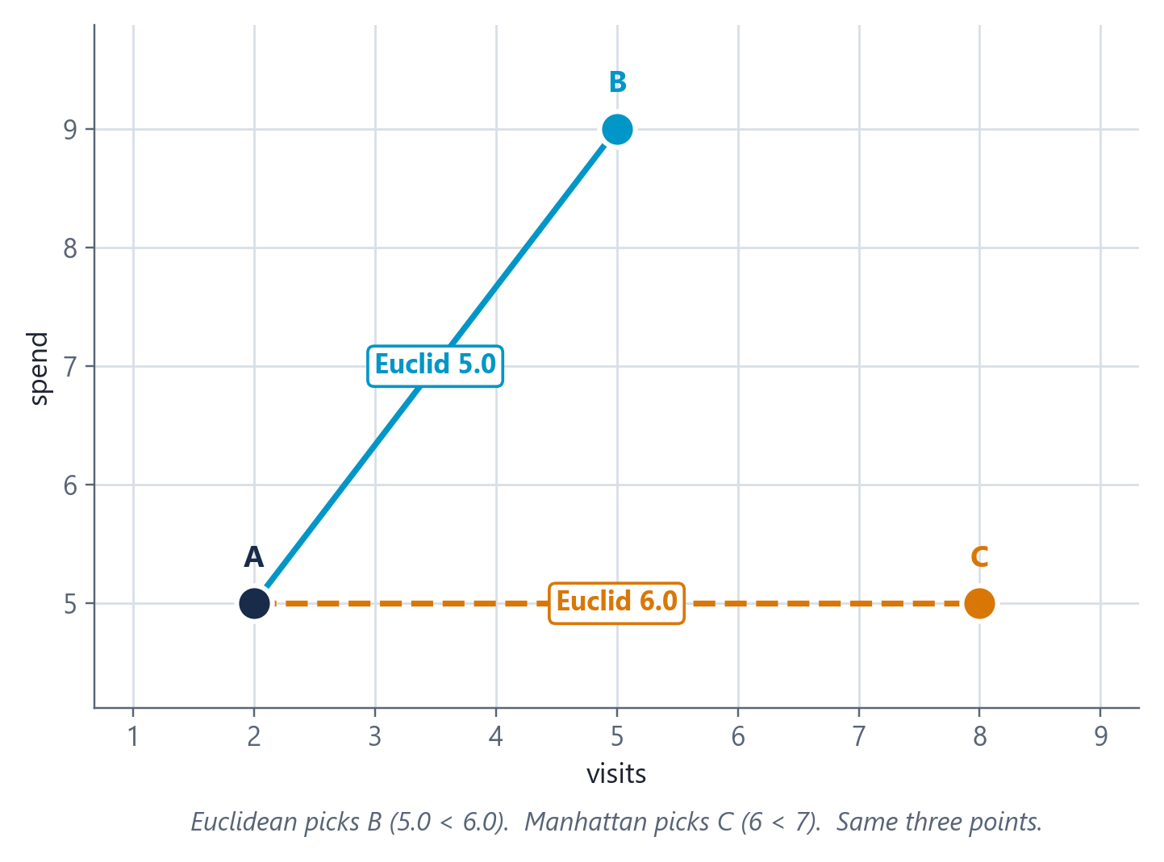
1.4 DISTANCE AND SIMILARITY
UNIT 1
Euclidean and Manhattan Disagree - Drawn
HOW TO READ THIS FIGURE
A → B differs by 3 in visits AND 4 in spend - spread across both features.
A → C differs by 6 in visits and 0 in spend - one big gap, concentrated.
Euclidean squares so 36 beats 25. The single big gap is punished harder. B wins.
Manhattan adds so 6 beats 7. Spreading the difference costs more. C wins.
Same points opposite answers to 'who is A's nearest neighbour?'
TAKEAWAY If the metric can flip the nearest neighbour of three points, think what it does to 50,000.
INT396 · Unit 1: Foundations of Unsupervised Learning
33

Slide 34
1.4 DISTANCE AND SIMILARITY
UNIT 1
Cosine vs Euclidean - Which Question Are You Asking?
Clustering by (Age, Income) is a Euclidean question. Clustering by purchased-item lists is a Cosine question.
Sensitive to magnitude. Two documents with the same proportions but different lengths are far apart.
Good for physical measurements, coordinates, standardised continuous features where size genuinely matters.
Example where it is right two customers with similar visit counts and similar spend really ARE similar customers.
Example where it fails a 200-word and a 2,000-word article on the same match look completely different.
Watch out for unscaled features - the largest-range feature silently takes over.
Sensitive to proportion only. Magnitude is divided out entirely.
Good for text, ratings, sparse high-dimensional counts - anywhere 'how much' is not the point.
Example where it is right recommending news articles on the same topic regardless of article length.
Example where it fails if magnitude genuinely matters. A customer spending Rs. 100 and one spending Rs. 100,000 in the same proportions look IDENTICAL to cosine.
Watch out for using it when 'how much' is exactly what the business cares about.
Euclidean asks: how far apart?
Cosine asks: same direction?
(Age, Income)
magnitude MEANS something → Euclidean
Ratings 1-10
some raters are generous → Cosine
Purchased items
list length is noise → Cosine
Customer VALUE
spend size is the point → Euclidean
CHOOSE Recommending films from ratings out of 10, where some users rate everything high and some rate everything low. Which metric - and why?
INT396 · Unit 1: Foundations of Unsupervised Learning
34

Slide 35
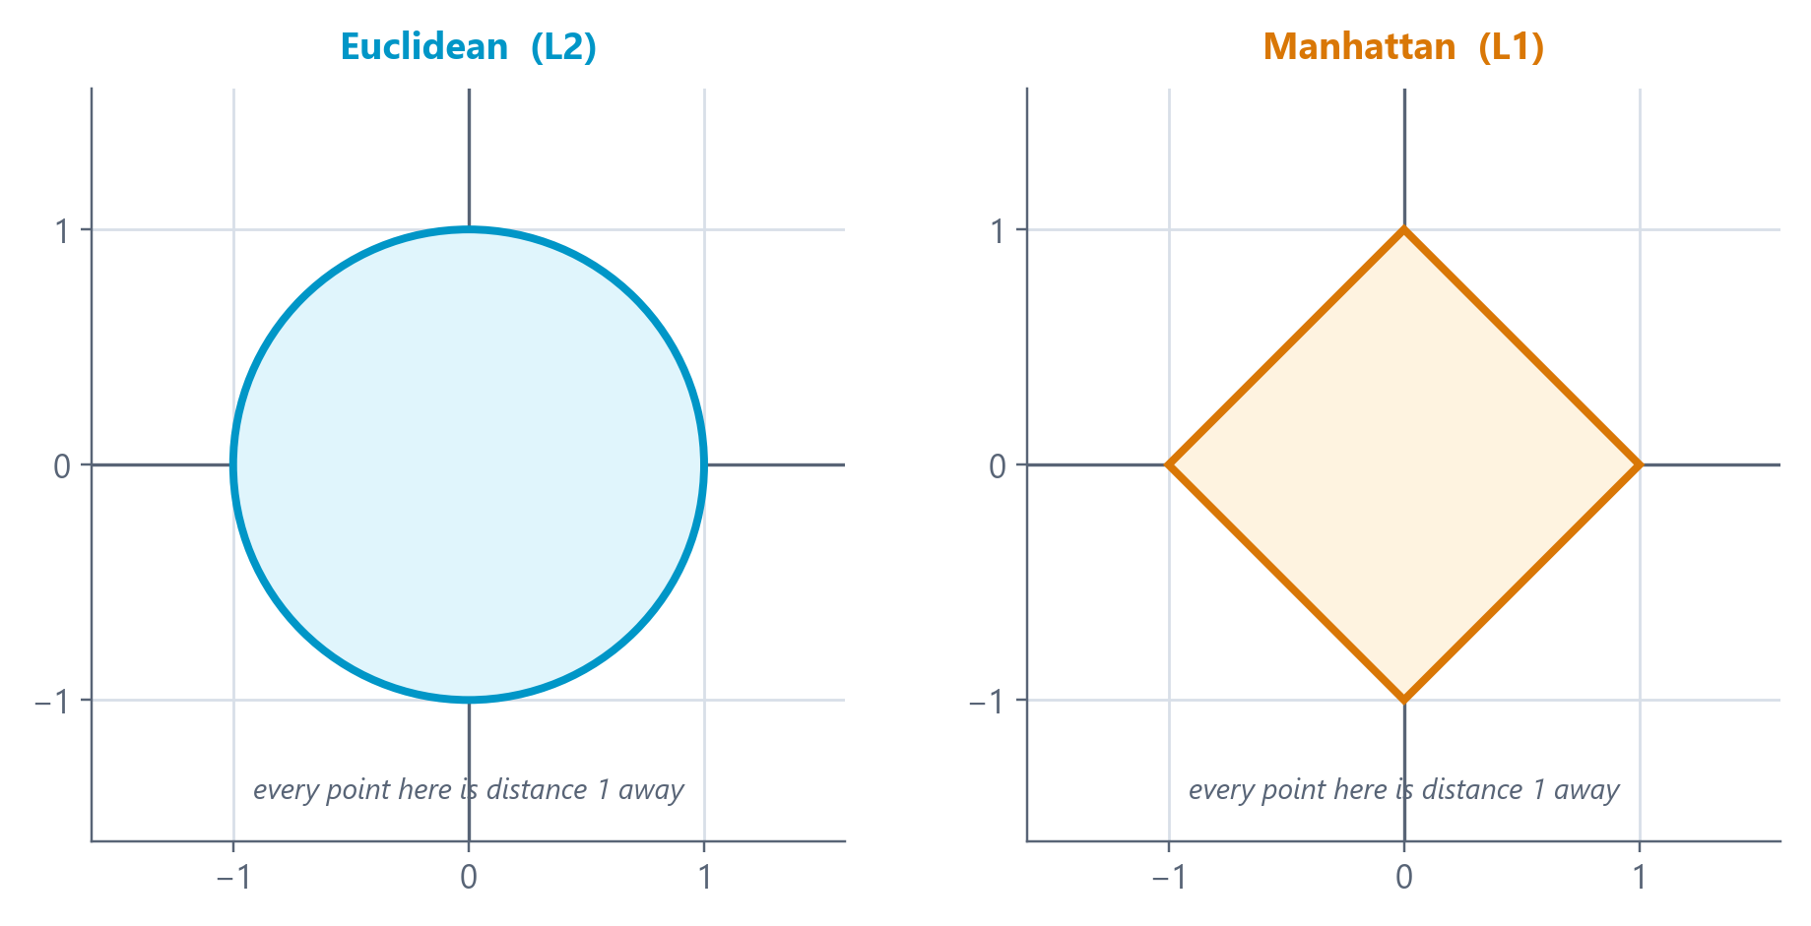
1.4 DISTANCE AND SIMILARITY
UNIT 1
'Nearby' Is a Different Shape in Each Metric
HOW TO READ THIS FIGURE
Both shapes contain every point at distance exactly 1 from the centre.
Euclidean gives a CIRCLE - the same in every direction.
Manhattan gives a DIAMOND - reaching further along the axes than diagonally.
Why the diamond moving diagonally costs you in BOTH coordinates, and Manhattan adds them.
The consequence clusters inherit these shapes - which is why the same algorithm gives different groups.
TAKEAWAY Choosing a metric is choosing what shape 'nearby' has.
INT396 · Unit 1: Foundations of Unsupervised Learning
35

Slide 36
05
IN THIS SECTION
The scaling pitfall - and how to fix it
A worked demonstration: same data, opposite answers
The curse of dimensionality
A decision guide for choosing a metric
SECTION
When and Why the Choice of Distance Matters
1 · Paradigms
2 · Formulation
3 · Use cases
4 · Metrics
5 · Why it matters
you are here

Slide 37
1.5 WHY DISTANCE CHOICE MATTERS
UNIT 1
The Scaling Pitfall - The Most Common Error in This Subject
The setup you cluster people using two features: HEIGHT in centimetres (range roughly 150-190) and WEIGHT in kilograms (range roughly 45-100).
What you assume both features contribute equally to the distance. It feels fair - one feature each.
What actually happens height varies over ~40 units, weight over ~55. Both contribute, but not equally - and if one were in MILLIMETRES the imbalance becomes enormous.
The extreme version cluster customers by AGE (18-70) and INCOME (20,000-2,000,000). Income spans a range 30,000 times larger. Age contributes essentially nothing to the distance.
The consequence your 'customer segments' are income bands wearing a disguise. Age is in the model and has no influence whatsoever.
Why it is dangerous nothing errors. Nothing warns you. The code runs, the clusters look plausible, and the conclusion is wrong.
RANGE OF EACH FEATURE
COMMON PITFALL · Unequal ranges mean unequal influence - silently
age
52
income
2.0M
squared: 2,700 vs 4,000,000,000,000
PREDICT Unscaled, what percentage of the distance does age contribute? Write a number.
INT396 · Unit 1: Foundations of Unsupervised Learning
37

Slide 38
1.5 WHY DISTANCE CHOICE MATTERS
UNIT 1
The Fix: Put Every Feature on the Same Scale
Standardise before you compute distances. This is not optional polish - it decides your answer.
STANDARDISATION (Z-SCORE) - THE USUAL DEFAULT
z = (x − μ) / σ
Each feature ends with mean 0 and standard deviation 1. Keeps outliers visible. Use unless you have a reason not to.
WHERE, AND WHEN TO USE IT
μ the mean of that feature across all objects
σ the standard deviation of that feature
After z-scoring every feature has mean 0, std 1 - so all features get equal say
Z-score vs min-max z-score keeps outliers visible; min-max lets one outlier squash everything else
Do NOT scale when features are already comparable (all counts of the same kind) or when relative magnitude IS the signal
Order matters fit the scaler, then compute distances. Never scale after clustering.
MIN-MAX NORMALISATION
x′ = (x − xₘᵢₙ) / (xₘₐₓ − xₘᵢₙ)
Squeezes every feature into [0, 1]. Bounded and intuitive - but one extreme outlier compresses everything else.
WORKED: INCOME 2,00,000 IN A SET WITH Μ = 5,00,000, Σ = 3,00,000
z = (200000 − 500000) / 300000 = −1.0
One standard deviation below the mean - now directly comparable with a z-score for age.
STANDARDISATION
z = (x − μ) / σ
how many standard deviations from normal — and that is DIMENSIONLESS
INT396 · Unit 1: Foundations of Unsupervised Learning
38

Slide 39
HANDS-ON DEMONSTRATION
UNIT 1
Demonstration: Same Data, Unscaled vs Scaled
THE PROBLEM
Customer P = (age 25, income 3,00,000)
Customer Q = (age 26, income 9,00,000)
Customer R = (age 55, income 3,20,000)
Question: which customer is P more similar to - Q or R?
STEP-BY-STEP SOLUTION
UNSCALED, Euclidean P→Q √[(25−26)² + (300000−900000)²] = √[1 + 3.6×10¹¹] ≈ 600,000
UNSCALED, Euclidean P→R √[(25−55)² + (300000−320000)²] = √[900 + 4×10⁸] ≈ 20,000
Unscaled verdict P is far closer to R. Age contributed 900 against hundreds of millions - it was invisible.
Now standardise suppose age has μ=40, σ=15 and income has μ=5,00,000, σ=3,00,000.
SCALED P = (−1.00, −0.67) SCALED Q = (−0.93, 1.33), SCALED R = (1.00, −0.60)
SCALED Euclidean P→Q √[(−1.00+0.93)² + (−0.67−1.33)²] = √[0.005 + 4.00] ≈ 2.00
SCALED Euclidean P→R √[(−1.00−1.00)² + (−0.67+0.60)²] = √[4.00 + 0.005] ≈ 2.00
Scaled verdict Now essentially TIED - because P differs from Q by 2σ of income, and from R by 2σ of age. Both features finally count.
WHY IT MATTERS
Unscaled, a 30-year age gap counted for less than a 20,000 income gap
After scaling, a 2σ difference in either feature carries equal weight
Nothing in the code changed - only the units the data was expressed in
UNSCALED
R wins
by a factor of about 30
STANDARDISED
a tie
both ≈ 2.00
ANSWER Unscaled: R wins easily. Scaled: it is a tie. Scaling changed the answer.
only the units changed
INT396 · Unit 1: Foundations of Unsupervised Learning
39

Slide 40
1.5 WHY DISTANCE CHOICE MATTERS
UNIT 1
The Curse of Dimensionality - Distance Gets Less Useful as Features Grow
The phenomenon as you add features, the distance between the nearest and the farthest point shrinks towards zero RELATIVE to the distances themselves.
Why it happens every extra dimension adds another squared difference to the sum. With enough dimensions, every pair accumulates a similar total - so all distances converge.
The consequence 'nearest neighbour' stops being meaningful. If everything is equally far, clustering has nothing to grip on.
Symptoms you will see clusters that look arbitrary; results that change completely on a small data change; silhouette scores hovering near zero.
What to do about it select fewer, better features; reduce dimensions (PCA, t-SNE - your Unit III); or use cosine similarity, which is more robust in sparse high-dimensional spaces.
The counter-intuitive lesson adding a feature is not free. An irrelevant feature does not just fail to help - it actively dilutes every distance you compute.
THREE SYMPTOMS IN THE LAB
COMMON PITFALL · In high dimensions, everything is roughly equally far apart
clusters look arbitrary
1
results flip on a re-run
2
silhouette hovers near zero
3
suspect dimensions, not the algorithm
→
PREDICT You have 50 customers and 300 features. What do you expect your clustering to look like - and why?
INT396 · Unit 1: Foundations of Unsupervised Learning
40

Slide 41
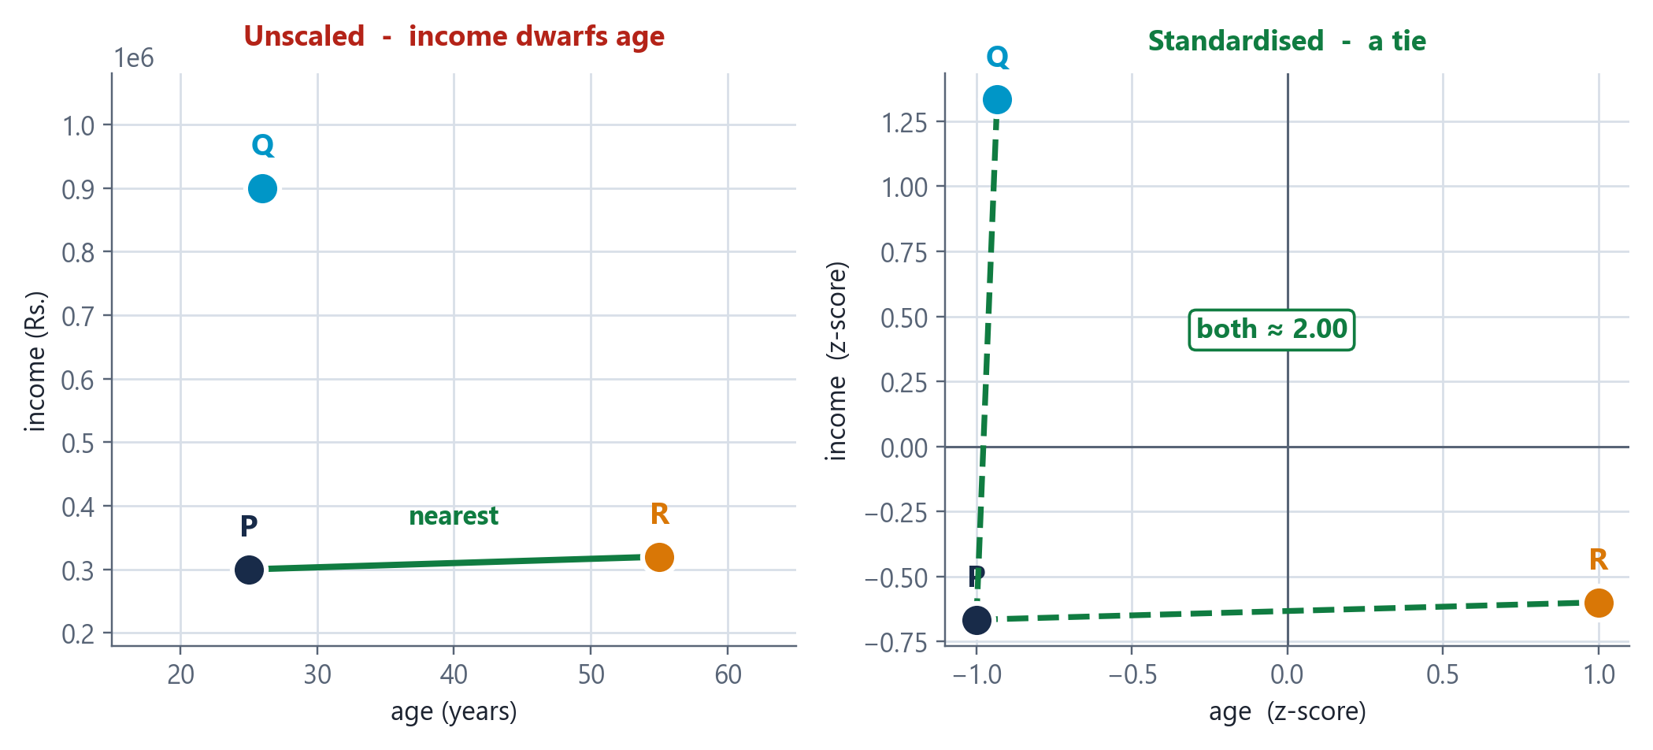
1.5 WHY DISTANCE CHOICE MATTERS
UNIT 1
The Same Three Customers, Unscaled and Scaled
HOW TO READ THIS FIGURE
Left - unscaled the axes are age (0-60) and income (up to 10 lakh). Age is invisible.
The green line P's nearest neighbour is R, by a factor of about 30.
Right - standardised both axes are now z-scores, so both span roughly −2 to +2.
The two dashed lines P→Q and P→R are now the same length. A dead tie.
Nothing changed except the units. Same data, same algorithm, reversed answer.
TAKEAWAY A 30-year age gap counted for less than a 20,000 income gap - until you standardised.
INT396 · Unit 1: Foundations of Unsupervised Learning
41

Slide 42
1.5 WHY DISTANCE CHOICE MATTERS
UNIT 1
Choosing a Metric - A Decision Guide
Not a ranking - a mapping from the shape of your data to the right question to ask of it.
If your data is... | Use | Because
Continuous features on comparable scales (after standardising) | Euclidean | Straight-line closeness is meaningful and magnitude matters
Movement constrained to axes - grids, aisles, city blocks | Manhattan | It measures the distance actually travelled, not the impossible shortcut
Contains outliers you do not want dominating | Manhattan | No squaring, so one huge gap does not swamp the sum
Text, documents, or word counts | Cosine | Length is noise; the proportion of topics is the signal
Ratings where users differ in generosity | Cosine | Removes the overall level and keeps the pattern of preference
Sparse and very high-dimensional | Cosine | More robust than Euclidean when distances start to concentrate
Features on wildly different ranges | STANDARDISE FIRST | Then choose. No metric survives unscaled features.
USE IT NOW Take the dataset from your practical. Walk the table and pick a row.
INT396 · Unit 1: Foundations of Unsupervised Learning
42

Slide 43
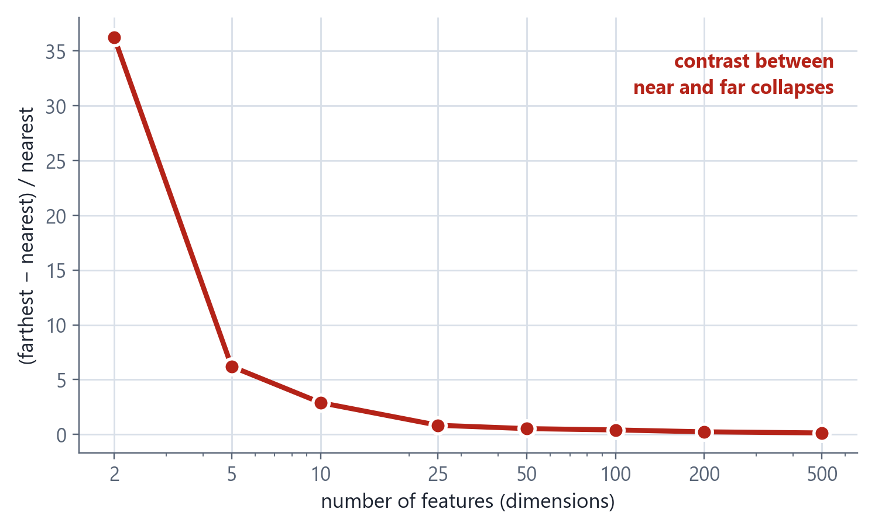
1.5 WHY DISTANCE CHOICE MATTERS
UNIT 1
The Curse of Dimensionality, Measured
HOW TO READ THIS FIGURE
The measurement pick a point; compare its nearest and its farthest neighbour.
Low dimensions the farthest is many times farther. Real contrast between near and far.
High dimensions the ratio collapses - everything is roughly equidistant.
Consequence 'nearest neighbour' stops meaning anything, so clustering has nothing to grip on.
Responses fewer, better features; dimensionality reduction; or cosine, which holds up better when data is sparse.
TAKEAWAY Adding an irrelevant feature does not merely fail to help - it dilutes every distance you compute.
INT396 · Unit 1: Foundations of Unsupervised Learning
43

Slide 44
CHECK YOUR UNDERSTANDING
UNIT 1
Which Metric? - Rapid Fire
QUICK CHECK
You are clustering research papers using word-frequency vectors. Papers range from 4-page letters to 60-page reviews. Which metric, and why?
THE ONE-LINE GUIDE
continuous, comparable, size matters
E
grid movement, counts, outliers
Euclidean, because word counts are continuous numbers
Manhattan, because it is robust to the outlier long papers
M
A
B
text, ratings, sparse - size is noise
Cosine, because paper length is noise and topic proportion is the signal
Euclidean after min-max normalisation of every word count
C
C
D
different ranges? SCALE FIRST
ANSWER: C A 60-page review has roughly 15× the word counts of a 4-page letter on the SAME topic - so Euclidean and Manhattan both see a huge gap where there is none. Cosine divides out magnitude entirely and compares only the direction of the vector, i.e. the proportion of each topic. This is the textbook case for cosine similarity.
!
◆ click to reveal the answer
INT396 · Unit 1: Foundations of Unsupervised Learning
44

Slide 45
1.4-1.5 CONSOLIDATION
UNIT 1
Activity: Choose the Metric, Defend the Choice
GROUP WORK · 12 minutes
In groups of 3-4, take one scenario. Decide the features, whether to scale, and which metric - then defend it against the obvious alternative.
Pick a scenario
Grouping LPU students by their canteen spending patterns
Recommending songs from listening histories
Detecting unusual electricity usage in campus buildings
Grouping cities by climate measurements
Specify it
What is the OBJECT - one row of your data?
Which 3-5 features would you use?
What are their likely ranges?
Decide and justify
Do you need to standardise? Why or why not?
Euclidean, Manhattan or Cosine?
Finish the sentence: 'two objects are similar when ___'
Argue the other side
Name the strongest alternative metric
Say specifically what would go wrong if you used it
If you genuinely cannot decide, say so and say why
1
2
3
4
DELIVERABLE One speaker per group: 60 seconds giving your object, your metric, your scaling decision, and the one sentence completing 'two objects are similar when ___'.
INT396 · Unit 1: Foundations of Unsupervised Learning
45

Slide 46
UNIT I RECAP
UNIT 1
Unit I - The Eight Ideas Worth Remembering
1
Three paradigms, decided by which labels you have
Supervised needs every label; unsupervised needs none; semi-supervised stretches a few across many. The paradigm is a property of the question, not of the data.
2
Unsupervised learning has no ground truth
So there is no accuracy score. Evaluate with internal measures, human judgement, or the downstream decision - and decide which BEFORE you run anything.
3
Formulation is harder without labels, not easier
The label silently defined the task, the success criterion, the relevant features and the stopping point. Remove it and all four become your decisions.
4
Five specifications make a problem well-posed
Objects · Features · Similarity · Structure sought · Success criterion. Anything left implicit gets decided by accident.
5
The four use-case families share one shape
The categories do not exist yet, labelling is impractical, data is abundant, discovery has value, and success is judged downstream.
6
Three metrics, three questions
Euclidean asks how far (crow flies). Manhattan asks how far along the grid (city blocks). Cosine asks whether they point the same way.
7
Unscaled features silently destroy your analysis
Age contributed 900 while income contributed 400 million. Standardise with z = (x − μ)/σ before computing any distance. Nothing will warn you.
8
The metric IS the definition of 'similar'
Same three customers, Euclidean said B and Manhattan said C. Change the metric and you change the answer - so choose it deliberately, not by default.
NEXT UP Unit II - Clustering Techniques: K-Means and choosing k, hierarchical clustering and dendrograms, DBSCAN for arbitrary shapes, and how to evaluate a clustering you cannot score.
INT396 · Unit 1: Foundations of Unsupervised Learning
46

